Slide 1
Machine learning speech sentiment analysis
Βυτινιώτης Κωνσταντίνος
Παπαδόπουλος Δημήτριος Ιάσων
Σιδηρόπουλος Μιχαήλ

Slide 2
Contents
Problem Statement
Datasets Overview
Feature Engineering
KNN
SVM
Model evaluation
Demo
Conclusions

Slide 3

Problem statement

Slide 4
Dataset overview

Slide 5
Feature engineering
Common Features for sentiment analysis using librosa
Mel frequency cepstral coefficients
Root mean square
Mel scaled spectrogram
Spectral centroid
Zero crossing rate

Slide 6
Support Vector Machine
Key Components of SVM:
SVMs aim to find the decision boundary
Support vectors are the data points that lie closest to the decision boundary
SVMs can employ the kernel trick to implicitly map the input data into a higher-dimensional space, where a linear decision boundary can be found.
Why we choose SVM:
Effective in High-Dimensional Spaces
Flexibility with Kernel Functions
Suitable for Multi-Class Classification through Kernel Functions

Slide 7
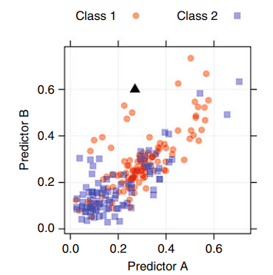
KNN
Parameters :
K neighbors (odd number)
Distance (Euclidean, Minkowski)
Features are scaled
Fast training-Slow testing

Slide 8
Model evaluation
Confusion Matrix
ROC curve

Slide 9
demo

Slide 10
conclusions

